Slide 1
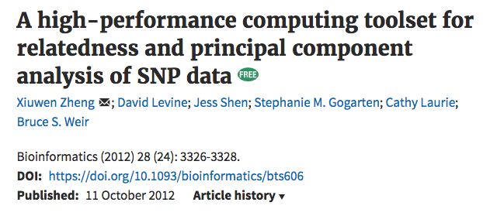
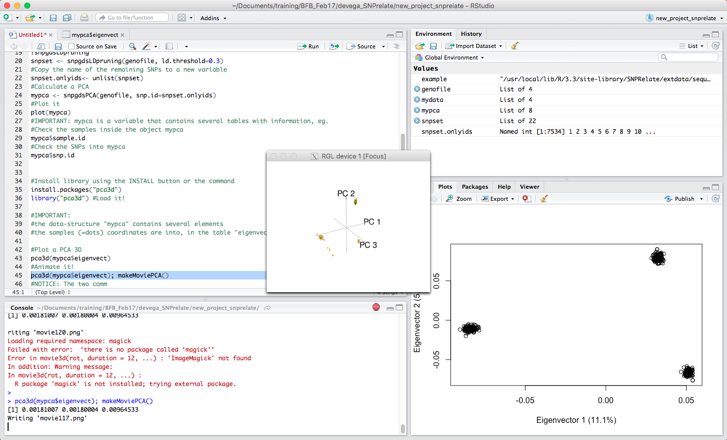
SNP relate
Relatedness analysis between samples (Eg. PCA natural diversity)
This is the final result, let’s go step by step…

Slide 2

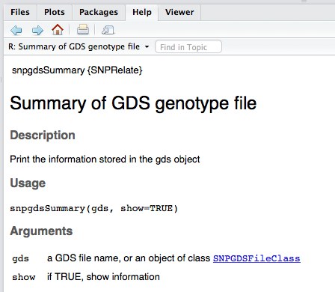
SNP relate (0): Prepare the workarea…
Open Rstudio and create a new project (File>New project) in a new empty folder
Install these two new package from Bioconductor repository:
source("http://bioconductor.org/biocLite.R")
biocLite("gdsfmt")
biocLite("SNPRelate")
# Load these R packages: gdsfmt and SNPRelate:
library(gdsfmt)
library(SNPRelate)
Check that all is working, run ?snpgdsSummary it should look like:

Slide 3
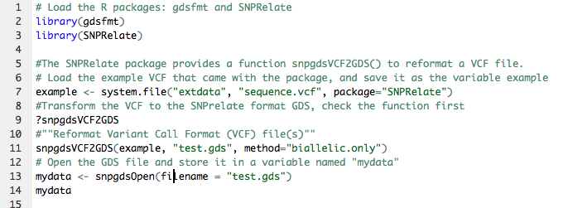
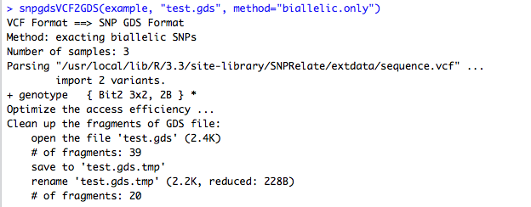
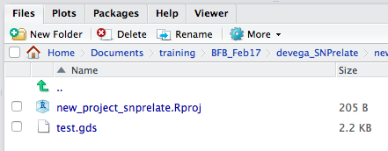
Workflow SNPrelate (1): How to import a VCF
Based on:
http://www.bioconductor.org/packages/release/bioc/vignettes/SNPRelate/inst/doc/SNPRelateTutorial.html

Slide 4
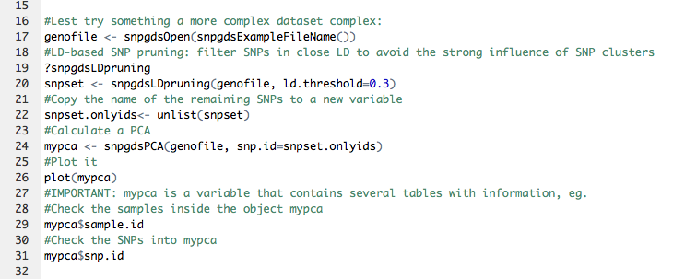
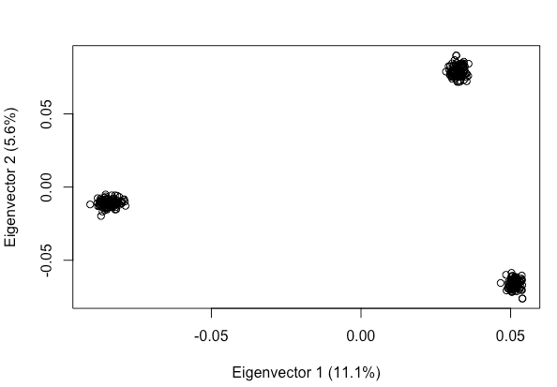
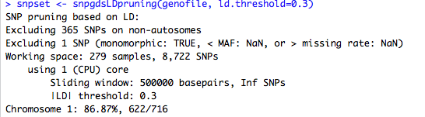
Workflow SNPrelate (2): Plotting a PCA

Slide 5
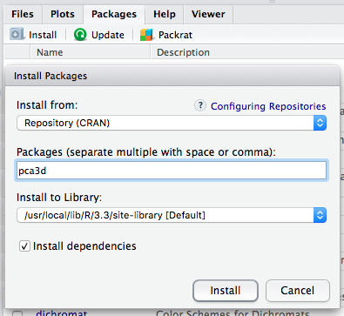
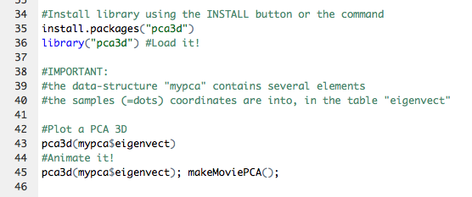
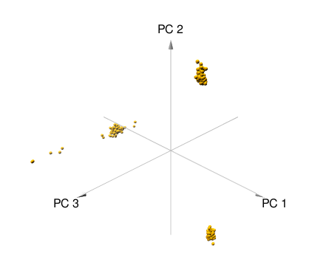
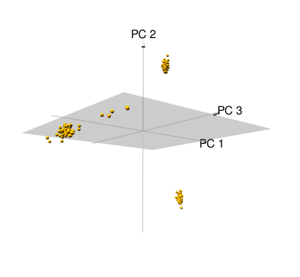
Workflow SNPrelate (3): Plot an animated 3D PCA

